Slide 1

Dockweiler State Beach
Trash Build-up & Littering

Slide 2

Research Question:
How does trash build up and littering at Dockweiler State Beach affect the experience of beach users, and what is being done to prevent and reduce the waste?

Slide 3
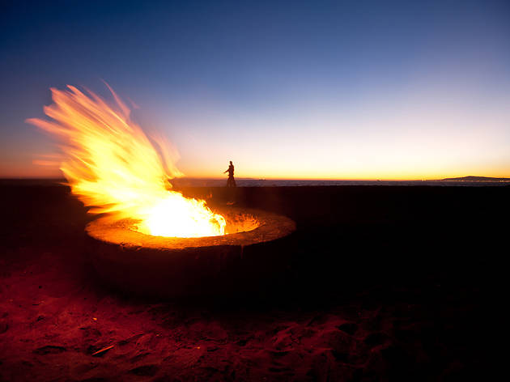
Setting: Dockweiler State Beach
Dockweiler State Beach is a popular beach site in California, known for its picnic-friendly atmosphere.
  The ocean is used for swimming in moderation.
  There are multiple bonfire pits across the sand.
    Patrons congregate around these fire pits to prepare food.

Slide 4
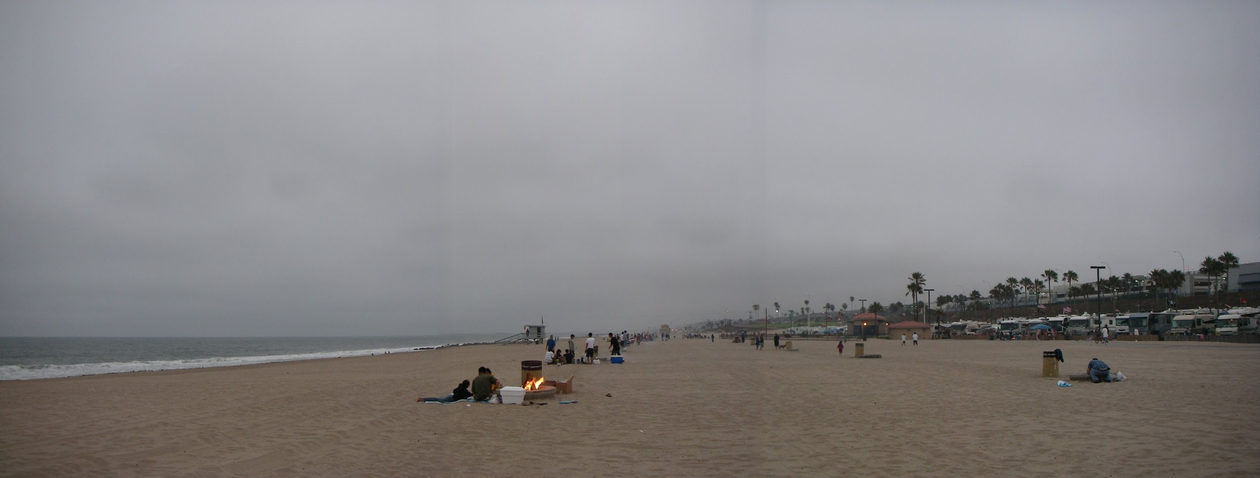
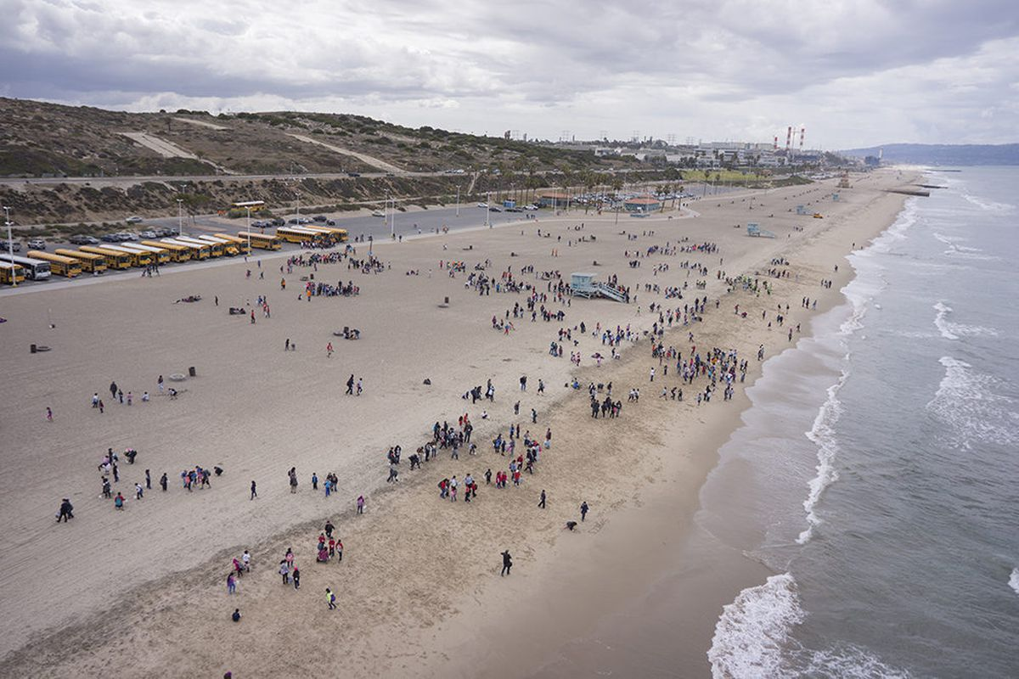
Setting: Dockweiler State Beach

Slide 5
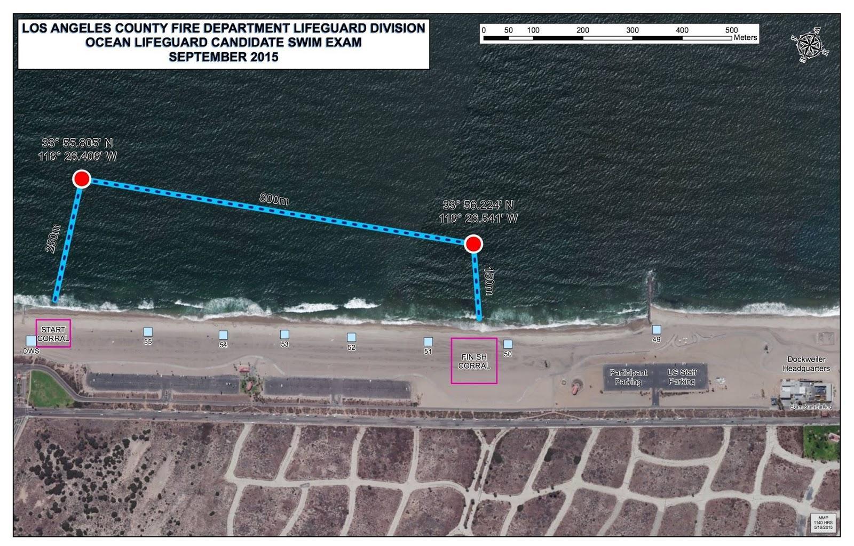
Setting: Dockweiler State Beach

Slide 6

Field Note Observation:
1st Observation: Afternoon
Gaining an understanding of the site
  How is the beach organized (parking lot location, trash bin placement)?
  What condition is the beach in?
  What percentage of the patrons are doing a picnic by the firepits? Why?
  What percentage of patrons are swimming? Why?
  What is the general mood and atmosphere of the space?
  Where in the space is the most trash building up?
  Are trash bins being utilized?
  Is active littering taking place?
  Which activities hold a higher probability to produce waste?

Slide 7
Field Note Observation:
2nd Observation: Sunset
How often do you frequent Dockweiler Beach?
Environmental issues with alcohol and smoking by the beach
  Leads to laziness and risky behavior
Leaving trash behind on the way out.
  There’s too much trash to dispose
  Cleaning out cars before leaving
3rd Observation: Mid-Day
Lack of patrolling and lifeguard duties
Children at the beach and teaching them to pick up after themselves
What is being done to prevent and reduce waste buildup?

Slide 8
Interview: Dockweiler Patron
First person account of interviewee’s experience at Dockweiler Beach.
  Los Angeles native
Comparison between the environmental condition of Dockweiler and other California beaches and beaches outside of California
Solution to cleanliness and a reduction of waste lies within the organization of the beach.
  California government should better fund its beaches
  Dockweiler lifeguards should stay until sundown and enforce cleanliness of environmental conditons.

Slide 9
Interview: Dockweiler Patron
Interviewer: “How do you feel about the environmental conditions at Dockweiler?”
Interviewee: “Specifically at Dockweiler, I feel like the issue starts at the parking lot as a matter of fact. It’s always dirty in the parking lot. Let me put it this way, There’s a lot of trash build up. I feel like there’s not enough places to throw away the trash. People will be like, “We’re just gonna be heading out so might as well leave our trash over here”. They might feel like “I’m not gonna leave it in the sand or throw it in the ocean but I’ll just leave it in the parking lot and be hoping somebody will be picking it up”.”

Slide 10
Interview: Dockweiler Patron
Interviewer: “What do you feel like is the main contributor to the dirtiness of the ocean/of the beach?”
Interviewee: “Well I think it starts from the bottom, where it’s the people attending the beach itself. They don’t pay no mind to it, they don’t mind dirtying it. And then it just slowly builds up and it goes to the people taking care of the beach, securities, lifeguards and what not, and then it goes back all the way up to the city itself not being able to control all the mess that’s going on over there, not enforcing the laws and people not worrying about getting into trouble from dirtying the beaches itself.”

Slide 11
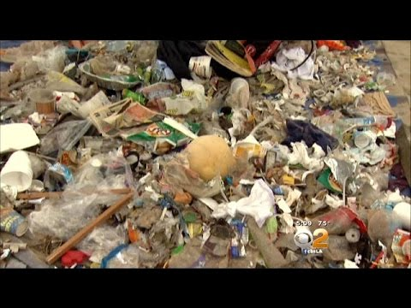
Research Focus: Volunteering

Slide 12
Preliminary Findings:
Trash Build up and Littering:
  Observational findings support the existence of both trash build up and littering
  Trash build up correlated with lack of trash bin sites and areas of denser sample groups (by the bonfire pits)
  Littering takes place at random occasions; mainly common among drunken people and children
The experience of beach users is not directly affected by trash build up, but the existence of a dirty environment allows for patrons to more easily contribute to the waste

Slide 13

Preliminary Findings:
What is being done to prevent and reduce waste?
Explicit signs of waste prevention were not present through observation
Interview and video interview provided feedback of the existence of community efforts to reduce waste.
3 Approaches:
Change the way the people act
Better enforce the actions of the people
Do not allow drinking and smoking

Slide 14
Limitations of the Research:
Research was done mainly using the qualitative methods learned in class
  Qualitative research provided useful insight of first hand experiences, but Dockweiler is such a popular beach and I could not fully capture multiple perspectives.
  The interview process limitations:
    The interviewee is a patron at the beach and is there to relax and have a good time
    Answering questions is not the funnest of activities for someone at the beach
    The lack of motivation and interest in the interview causes a tense atmosphere during the interview

Slide 15

Future Direction of Research:
The use of further qualitative research methods would provide a better understanding of how patrons of Dockweiler are interacting with the beach.
  In depth interviews of official workers (lifeguards, patrol officers) of Dockweiler to better understand whether improvements are being made; they have a longitudinal perspective.
The use of quantitative research methods would provide further understanding of the experience of patrons at Dockweiler.
  Survey methods to better understand the experience from multiple perspectives.

